Slide 1
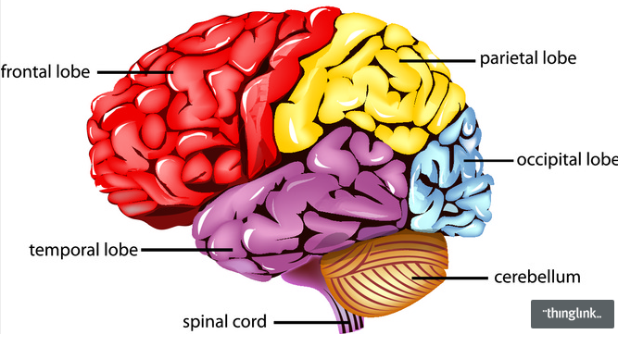
RNN

Slide 2
Output Layer
Hidden Layer
Input Layer

Slide 3
Output Layer
Output Layer
Hidden Layer
Input Layer
Input Layer

Slide 4
Output Layer
Output Layer
Hidden Layer
RNN Layer
Input Layer
Input Layer

Slide 5
=
…
Time

Slide 6
…
…
…
Time

Slide 7
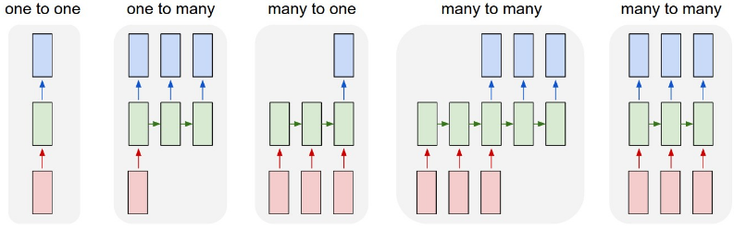
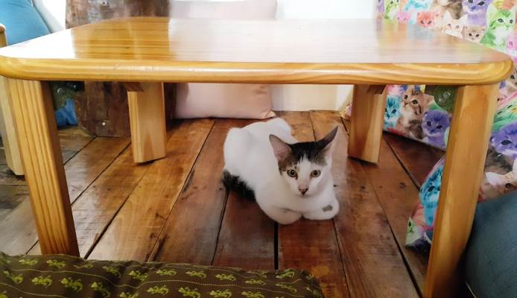
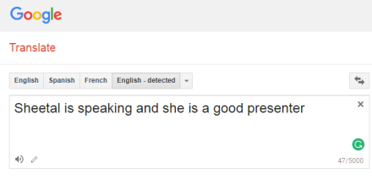

RNN - Applications
A horrified cat sitting under the table
Cat
Positive
I had an excellent stay at the hotel!!
Ref: http://karpathy.github.io/2015/05/21/rnn-effectiveness/

Slide 8
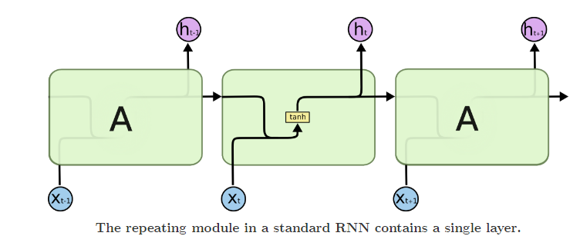
http://colah.github.io/posts/2015-08-Understanding-LSTMs/

Slide 9
Vanishing & Exploding Gradients
E0
E1
E2
E3
δE3/δS3
δS1/δS0
δS2/δS1
δS3/δS2
S0
S1
S2
S3
X0
X1
X2
X3
S3 = tanh(UX3 + WS2)

Slide 10
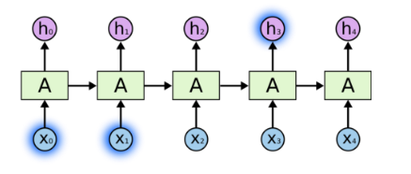
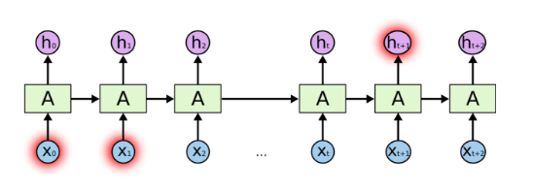
The clouds are in the sky
I grew up in France. I love to travel, I have travelled to several countries and I can speak fluent French

Slide 11
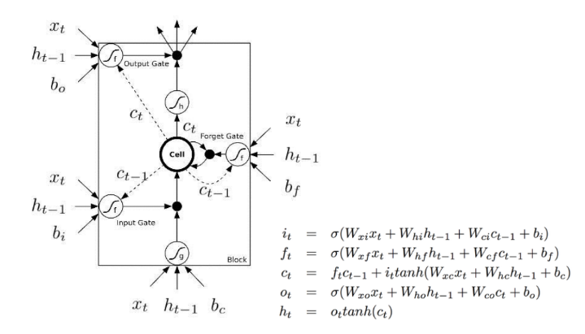
LSTM - Long Short Term Memory

Slide 12
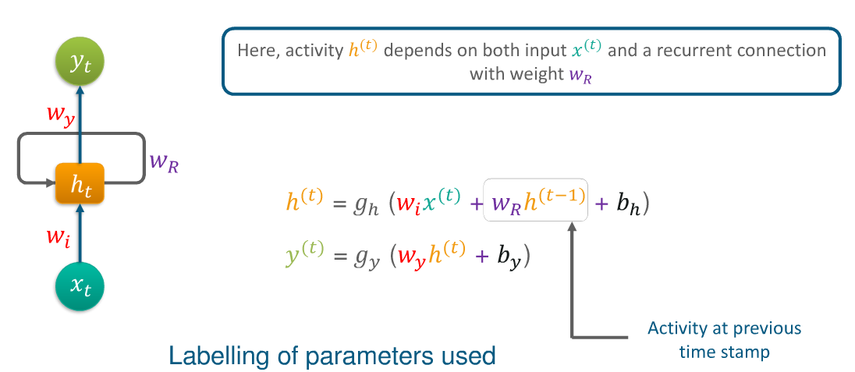
http://colah.github.io/posts/2015-08-Understanding-LSTMs/
http://karpathy.github.io/2015/05/21/rnn-effectiveness/

Slide 14
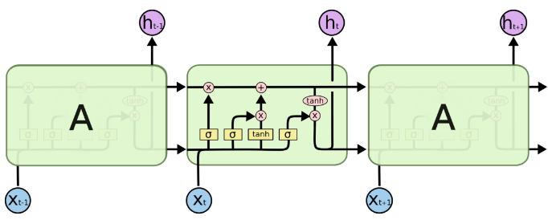

Slide 15
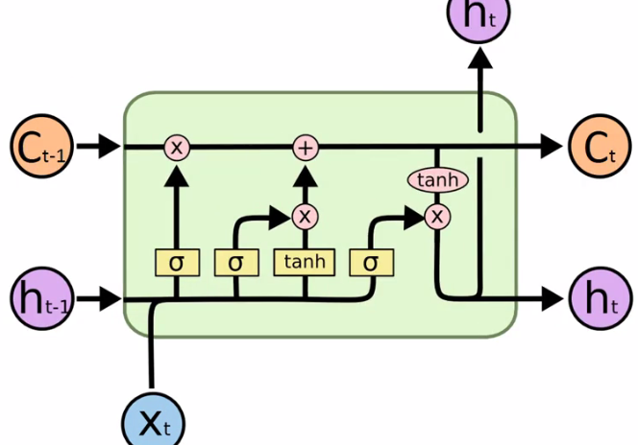

Slide 16
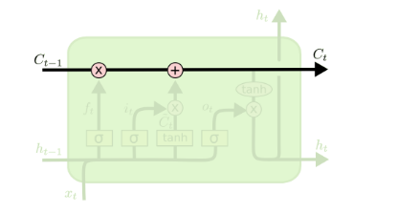
Rahul is taking a presentation. Rahul is explaining LSTMs. He understands LSTMs quite well

Slide 17
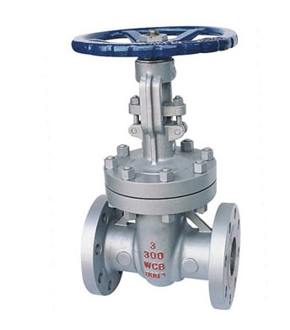
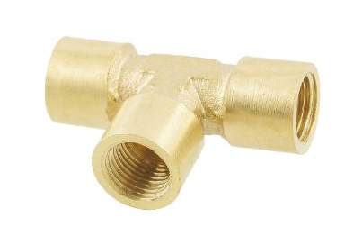

Slide 18
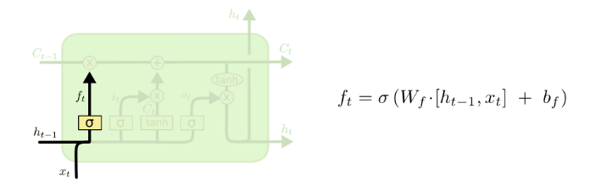
“Forget Gate ”
Rahul is taking a presentation. Ram, Rahul’s friend, ……

Slide 19
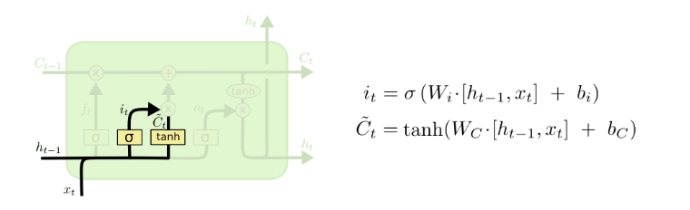
“Input Gate”
Rahul is taking a presentation. Ram, Rahul’s friend, is sleeping. He holds a PhD.

Slide 20
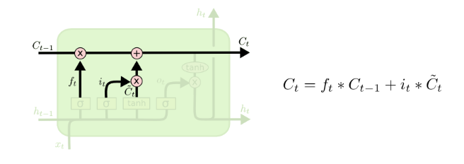

Slide 21
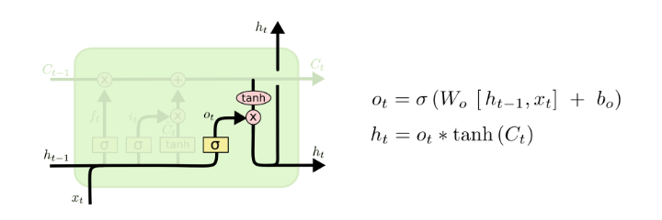
Rahul is taking a presentation. Ram, Rahul’s friend, is sleeping. He holds a PhD. They both are educated.

